Slide 1
Math 263: Discrete Mathematics
Agenda/Announcements/Reminders:
Dr. Walia Office Hours (on Zoom)
and by appointment.
On T,Th, I’ll also be available in-person in my office YR-353 and might be a few minutes late. On Fridays, I might be able to hold office hours from 3:30-4:30pm if requested ahead of time.
Please go to blackboard, click on “Zoom Meetings”, and then join the Zoom session “Office Hours” for the day. Recordings will be available soon after.
Online Tutoring Center link
Monday | Tuesday | Wednesday | Thursday
2:00-3:00pm | 3:30-4:30pm | 2:00-3:00pm | 3:30-4:30pm

Slide 2
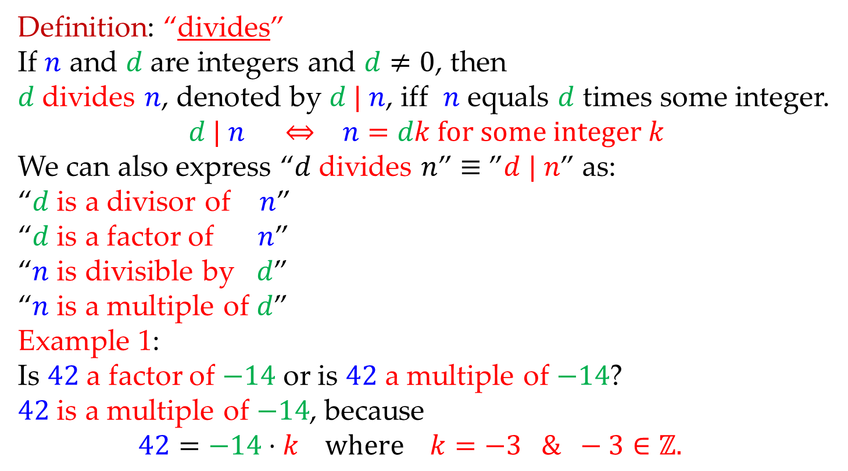
Math 263: Discrete Mathematics
4.4-4.5: Divides
Definition: “divides”
If $n$ and $d$ are integers and $d≠0$, then
$d$ divides $n$, denoted by $d | n$, iff $n$ equals $d$ times some integer.
$$d | n ⇔ n=dk for some integer k$$
We can also express “$d$ divides $n$” $≡$ ”$d | n$” as:
“$d$ is a divisor of $n$”
“$d$ is a factor of $n$”
“$n$ is divisible by $d$”
“$n$ is a multiple of $d$”
Example 1:
Is $42$ a factor of $−14$ or is $42$ a multiple of $−14$?
$42$ is a multiple of $−14$, because
$$42=−14⋅k where k=−3 \& −3∈ℤ.$$

Slide 3
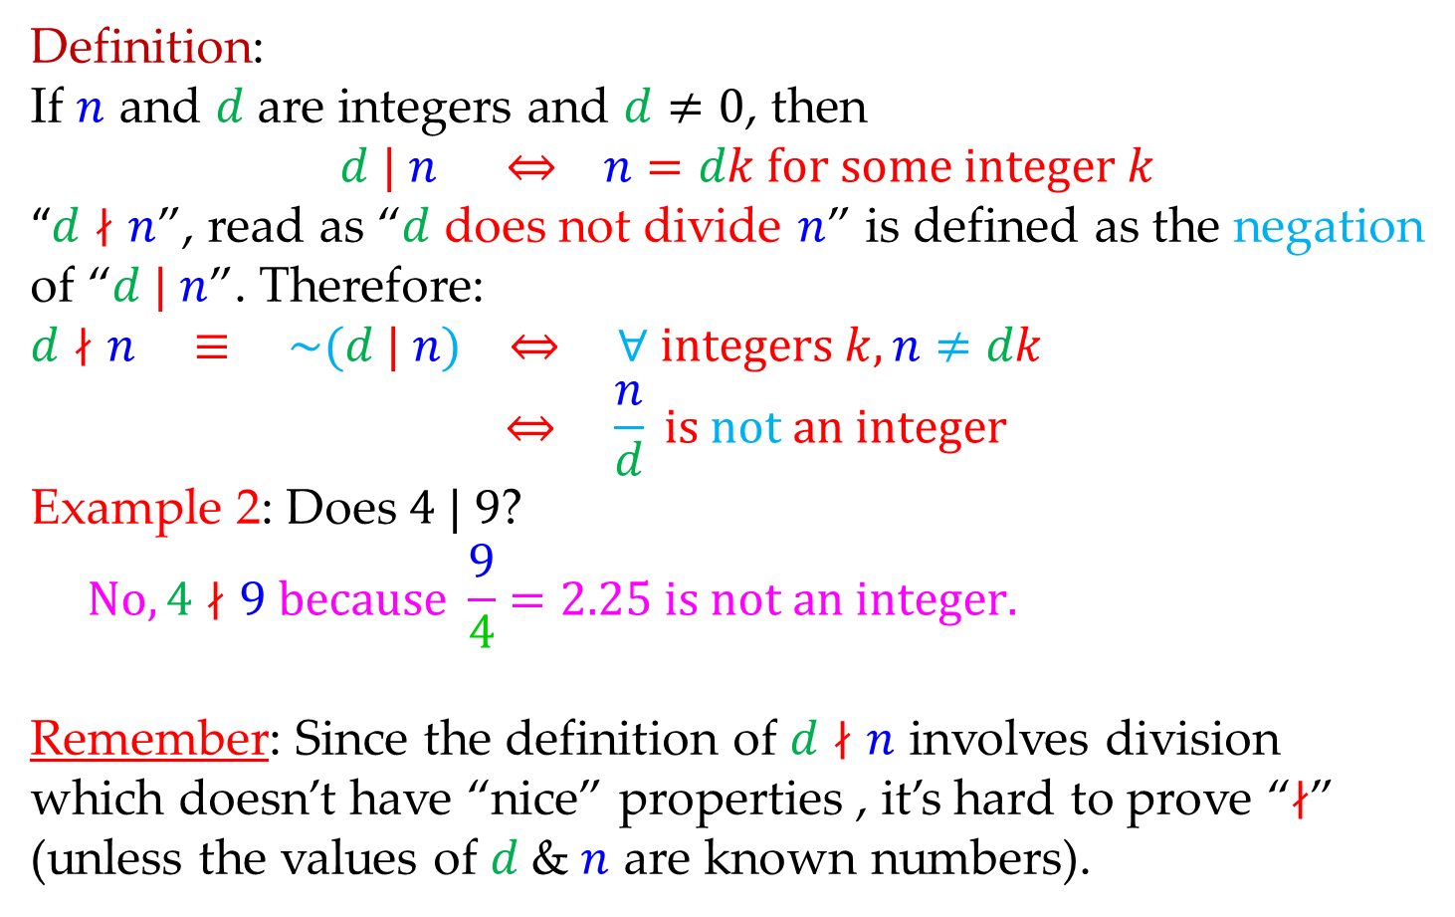
Math 263: Discrete Mathematics
4.4-4.5: Divides
Definition:
If $n$ and $d$ are integers and $d≠0$, then
$d | n ⇔ n=dk for some integer k$
“$d∤n$”, read as “$d$ does not divide $n$” is defined as the negation of “$d | n$”. Therefore:
$$d∤n ≡ \sim (d | n) ⇔ ∀ integers k, n≠dk$$
$$⇔ \frac{n}{d} is not an integer$$
Example 2: Does $4 | 9$?
$$No,4∤9 because \frac{9}{4}=2.25 is not an integer.$$
Remember: Since the definition of $d∤n$ involves division
which doesn’t have “nice” properties , it’s hard to prove “$∤$”
(unless the values of $d$ & $n$ are known numbers).

Slide 4
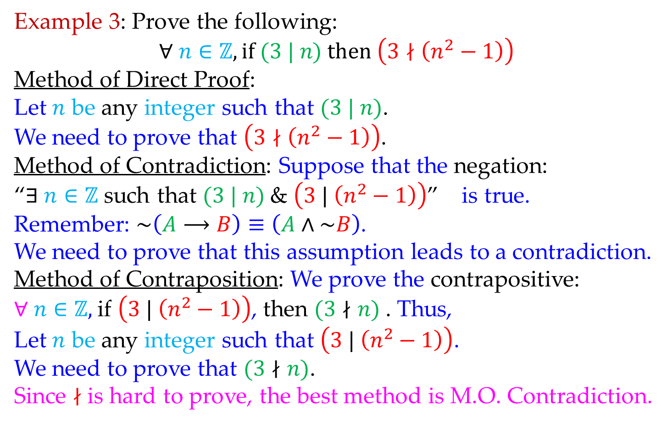
Math 263: Discrete Mathematics
4.7: (Indirect) Method of Contradiction
Example 3: Prove the following:
$$∀ n∈ℤ, if (3 | n) then \left(3∤\left(n^{2}−1\right)\right)$$
Method of Direct Proof:
Let $n$ be any integer such that $(3 | n)$.
We need to prove that $\left(3∤\left(n^{2}−1\right)\right)$.
Method of Contradiction: Suppose that the negation:
“$∃ n∈ℤ$ such that $(3 | n)$& $\left(3 | \left(n^{2}−1\right)\right)$” is true.
Remember: $\sim \left(A⟶B\right)≡\left(A∧\sim B\right)$.
We need to prove that this assumption leads to a contradiction.
Method of Contraposition: We prove the contrapositive:
$∀ n∈ℤ,$if $\left(3 | \left(n^{2}−1\right)\right)$, then $(3∤n)$. Thus,
Let $n$ be any integer such that $\left(3 | \left(n^{2}−1\right)\right)$.
We need to prove that $(3∤n)$.
Since $∤$ is hard to prove, the best method is M.O. Contradiction.

Slide 5
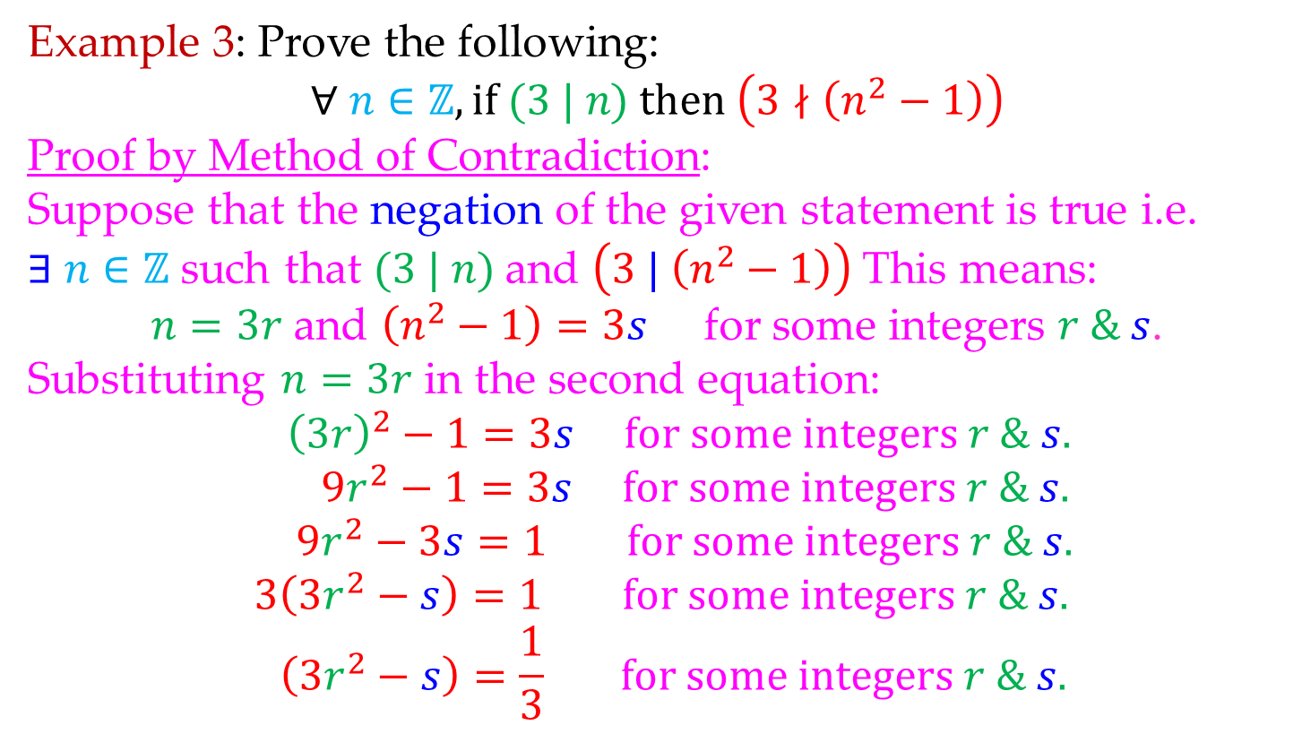
Math 263: Discrete Mathematics
4.7: (Indirect) Method of Contradiction
Example 3: Prove the following:
$$∀ n∈ℤ, if (3 | n) then \left(3∤\left(n^{2}−1\right)\right)$$
Proof by Method of Contradiction:
Suppose that the negation of the given statement is true i.e.
$∃$ $n∈ℤ$such that $(3 | n)$and $\left(3 | \left(n^{2}−1\right)\right)$This means:
$n=3r$ and $\left(n^{2}−1\right)=3s$ for some integers $r \& s$.
Substituting $n=3r$ in the second equation:
$${\left(3r\right)}^{2}−1=3s for some integers r \& s.$$
$$9r^{2}−1=3s for some integers r \& s.$$
$$9r^{2}−3s=1 for some integers r \& s.$$
$$3\left(3r^{2}−s\right)=1 for some integers r \& s.$$
$$\left(3r^{2}−s\right)=\frac{1}{3} for some integers r \& s.$$

Slide 6
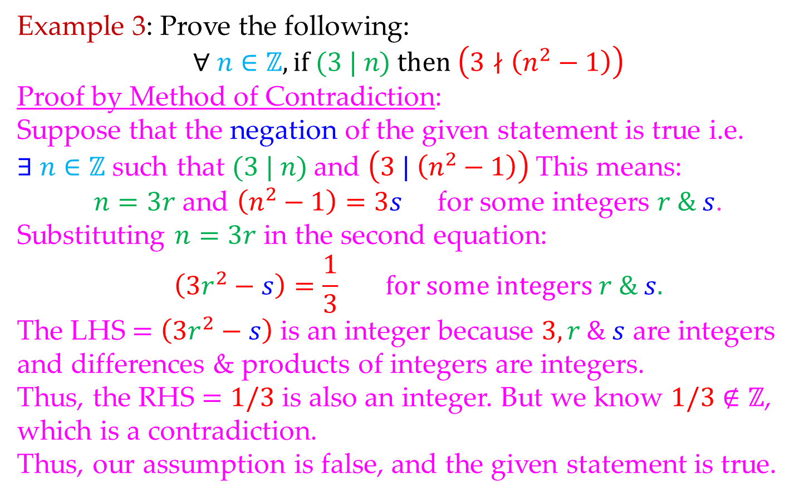
Math 263: Discrete Mathematics
4.7: (Indirect) Method of Contradiction
Example 3: Prove the following:
$$∀ n∈ℤ, if (3 | n) then \left(3∤\left(n^{2}−1\right)\right)$$
Proof by Method of Contradiction:
Suppose that the negation of the given statement is true i.e.
$∃$ $n∈ℤ$such that $(3 | n)$and $\left(3 | \left(n^{2}−1\right)\right)$This means:
$n=3r$ and $\left(n^{2}−1\right)=3s$ for some integers $r \& s$.
Substituting $n=3r$ in the second equation:
$$\left(3r^{2}−s\right)=\frac{1}{3} for some integers r \& s.$$
The LHS $=\left(3r^{2}−s\right)$ is an integer because $3,r \& s$ are integers
and differences & products of integers are integers.
Thus, the RHS $=1/3$ is also an integer. But we know $1/3$ $∉ℤ$,
which is a contradiction.
Thus, our assumption is false, and the given statement is true.

Slide 7
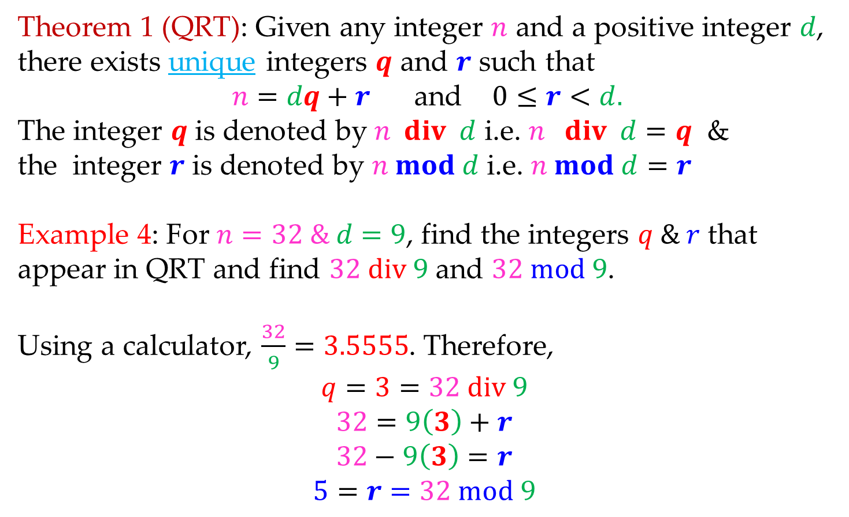
Math 263: Discrete Mathematics
4.5: Quotient Remainder Theorem (QRT)
Theorem 1 (QRT): Given any integer $n$ and a positive integer $d$, there exists unique integers $q$ and $r$ such that
$n=dq+r$ and $0≤r<d.$
The integer $q$ is denoted by $n div d$ i.e. $n div d=q$ &
the integer $r$ is denoted by $n mod d$ i.e. $n mod d=r$
Example 4: For $n=32 \& d=9$, find the integers $q \& r$ that appear in QRT and find $32 div 9$ and $32 mod 9$.
Using a calculator, $\frac{32}{9}=3.5555$. Therefore,
$$q=3=32 div 9$$
$$32=9\left(3\right)+r$$
$$32−9\left(3\right)=r$$
$$5=r=32 mod 9$$

Slide 8
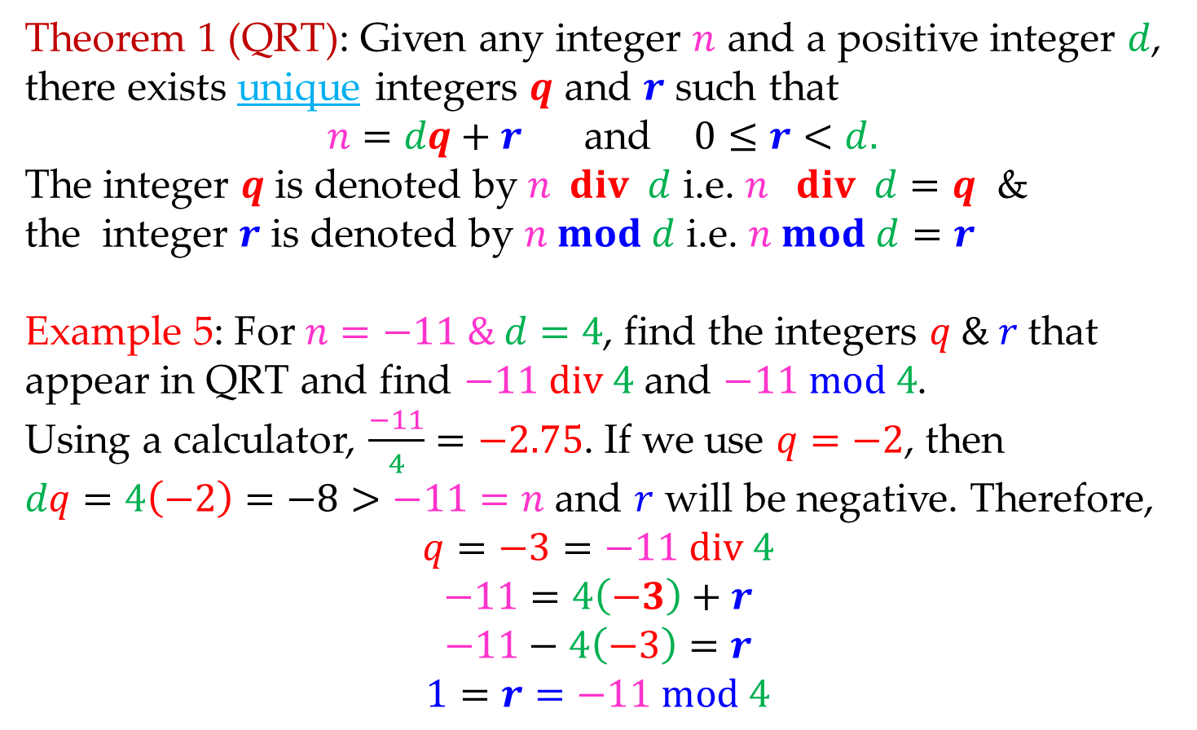
Math 263: Discrete Mathematics
4.5: Quotient Remainder Theorem (QRT)
Theorem 1 (QRT): Given any integer $n$ and a positive integer $d$, there exists unique integers $q$ and $r$ such that
$n=dq+r$ and $0≤r<d.$
The integer $q$ is denoted by $n div d$ i.e. $n div d=q$ &
the integer $r$ is denoted by $n mod d$ i.e. $n mod d=r$
Example 5: For $n=−11 \& d=4$, find the integers $q \& r$ that appear in QRT and find $−11 div 4$ and $−11 mod 4$.
Using a calculator, $\frac{−11}{4}=−2.75$. If we use $q=−2$, then
$dq=4\left(−2\right)=−8>−11=n$ and $r$ will be negative. Therefore,
$$q=−3=−11 div 4$$
$$−11=4\left(−3\right)+r$$
$$−11−4\left(−3\right)=r$$
$$1=r=−11 mod 4$$

Slide 9
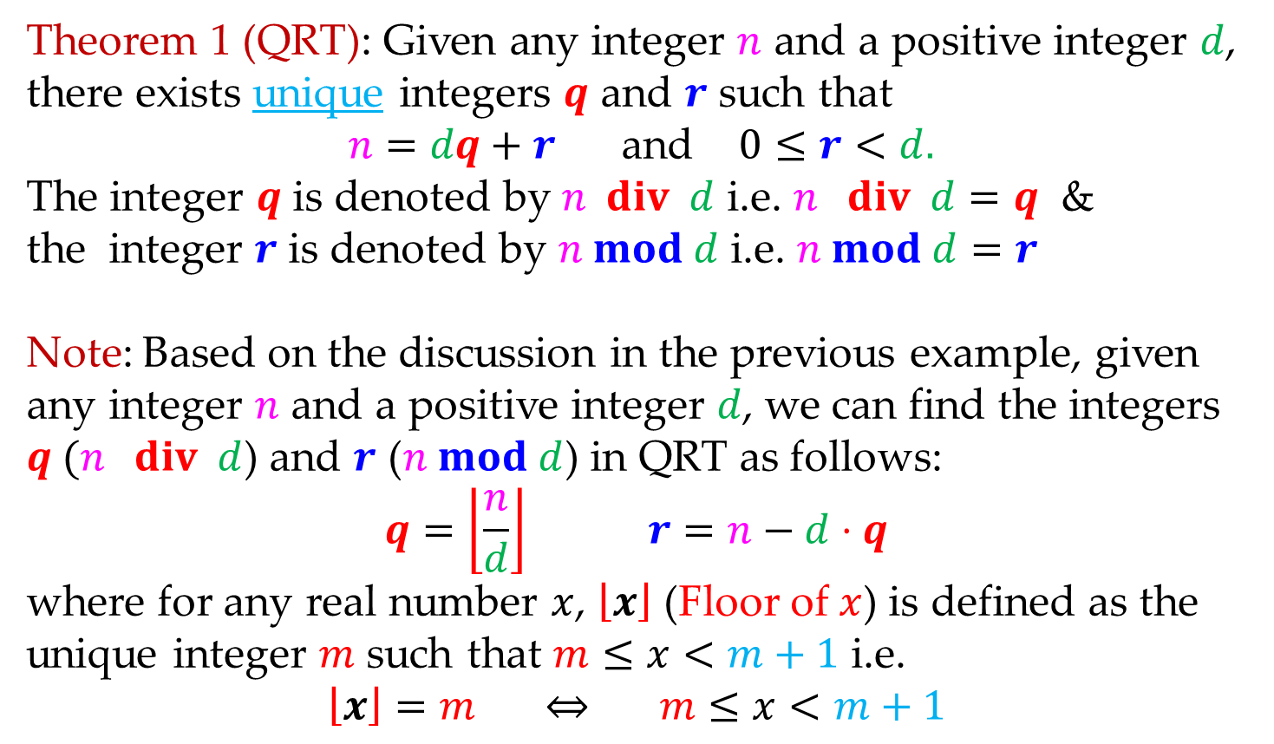
Math 263: Discrete Mathematics
4.5: Quotient Remainder Theorem (QRT)
Theorem 1 (QRT): Given any integer $n$ and a positive integer $d$, there exists unique integers $q$ and $r$ such that
$n=dq+r$ and $0≤r<d.$
The integer $q$ is denoted by $n div d$ i.e. $n div d=q$ &
the integer $r$ is denoted by $n mod d$ i.e. $n mod d=r$
Note: Based on the discussion in the previous example, given
any integer $n$ and a positive integer $d$, we can find the integers
$q (n div d$) and $r$ ($n mod d$) in QRT as follows:
$$q=\left\lfloor \frac{n}{d}\right\rfloor r=n−d⋅q$$
where for any real number $x$, $\left\lfloor x\right\rfloor$ (Floor of $x$) is defined as the
unique integer $m$ such that $m≤x<m+1$ i.e.
$$\left\lfloor x\right\rfloor =m ⇔ m≤x<m+1$$

Slide 10
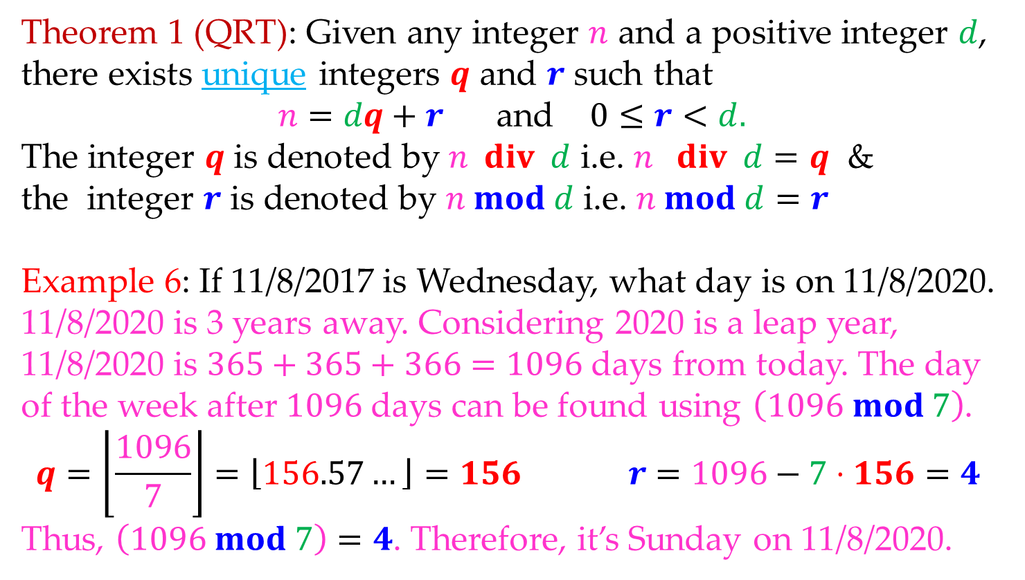
Math 263: Discrete Mathematics
4.5: Quotient Remainder Theorem (QRT)
Theorem 1 (QRT): Given any integer $n$ and a positive integer $d$, there exists unique integers $q$ and $r$ such that
$n=dq+r$ and $0≤r<d.$
The integer $q$ is denoted by $n div d$ i.e. $n div d=q$ &
the integer $r$ is denoted by $n mod d$ i.e. $n mod d=r$
Example 6: If 11/8/2017 is Wednesday, what day is on 11/8/2020.
11/8/2020 is 3 years away. Considering 2020 is a leap year,
11/8/2020 is $365+365+366=1096$ days from today. The day
of the week after $1096$ days can be found using $\left(1096 mod 7\right)$.
$$q=\left\lfloor \frac{1096}{7}\right\rfloor =\left\lfloor 156.57…\right\rfloor =156 r=1096−7⋅156=4$$
Thus, $\left(1096 mod 7\right)=4$. Therefore, it’s Sunday on 11/8/2020.

Slide 11
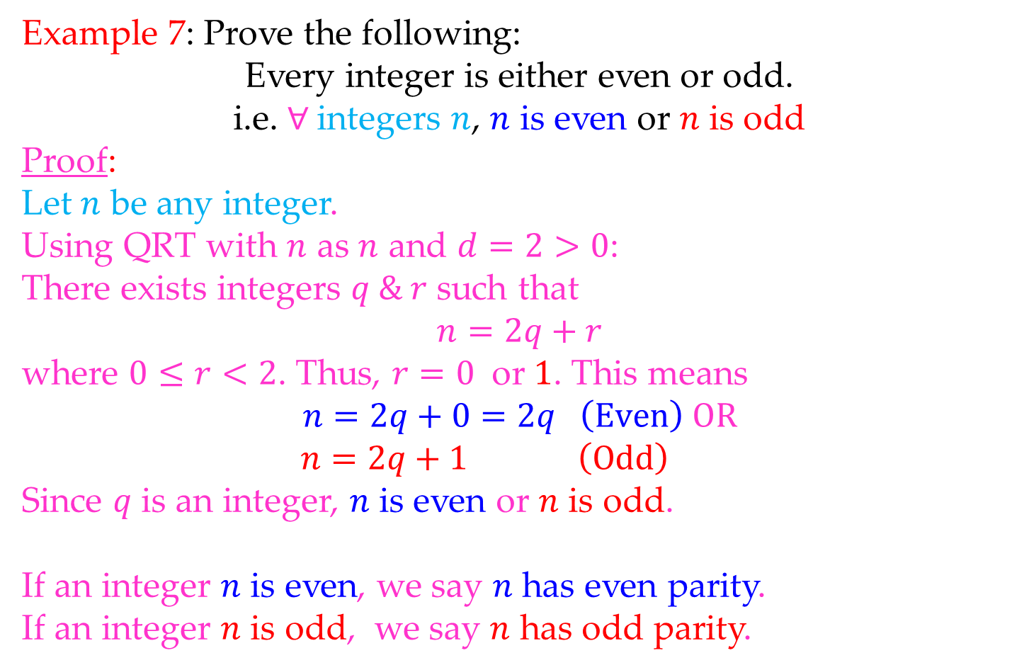
Math 263: Discrete Mathematics
4.5: Quotient Remainder Theorem (QRT)
Example 7: Prove the following:
Every integer is either even or odd.
i.e. $∀$integers $n$, $n$ is even or $n$ is odd
Proof:
Let $n$ be any integer.
Using QRT with $n$ as $n$ and $d=2>0$:
There exists integers $q \& r$ such that
$$n=2q+r$$
where $0≤r<2$. Thus, $r=0$ or $1$. This means
$$n=2q+0=2q \left(Even\right) OR$$
$$n=2q+1 \left(Odd\right)$$
Since $q$ is an integer, $n$ is even or $n$ is odd.
If an integer $n$ is even, we say $n$ has even parity.
If an integer $n$ is odd, we say $n$ has odd parity.

Slide 12
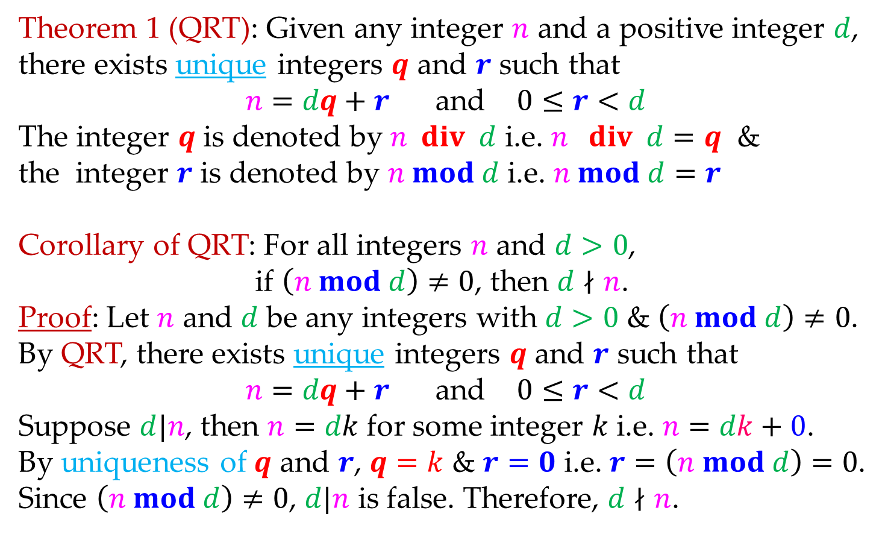
Math 263: Discrete Mathematics
4.5: Quotient Remainder Theorem (QRT)
Theorem 1 (QRT): Given any integer $n$ and a positive integer $d$, there exists unique integers $q$ and $r$ such that
$n=dq+r$ and $0≤r<d$
The integer $q$ is denoted by $n div d$ i.e. $n div d=q$ &
the integer $r$ is denoted by $n mod d$ i.e. $n mod d=r$
Corollary of QRT: For all integers $n$ and $d>0$,
if $\left(n mod d\right)≠0$, then $d∤n$.
Proof: Let $n$ and $d$ be any integers with $d>0$ & $\left(n mod d\right)≠0$.
By QRT, there exists unique integers $q$ and $r$ such that
$n=dq+r$ and $0≤r<d$
Suppose $d|n$, then $n=dk$ for some integer $k$ i.e. $n=dk+0$.
By uniqueness of $q$ and $r$, $q=k$ & $r=0$ i.e. $r=\left(n mod d\right)=0$.
Since $\left(n mod d\right)≠0$, $d|n$ is false. Therefore, $d∤n$.

Slide 13
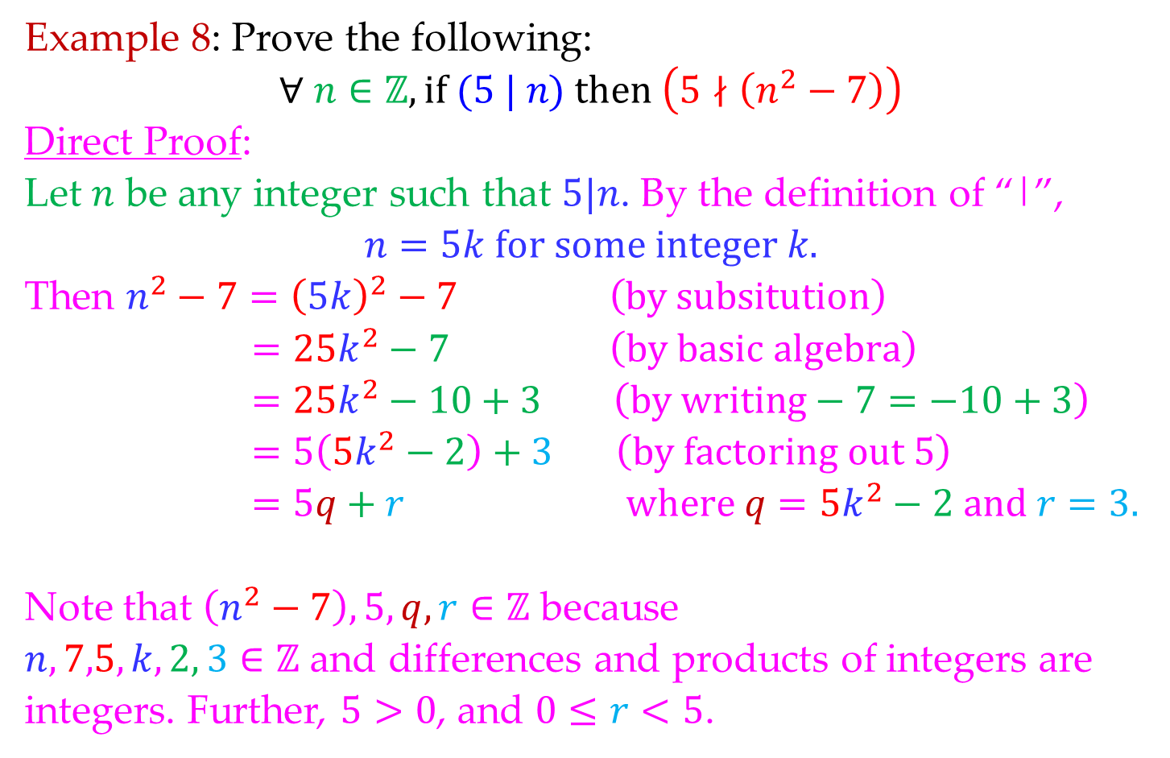
Math 263: Discrete Mathematics
4.5: Quotient Remainder Theorem (QRT)
Example 8: Prove the following:
$$∀ n∈ℤ, if (5 | n) then \left(5∤\left(n^{2}−7\right)\right)$$
Direct Proof:
Let $n$ be any integer such that $5|n$. By the definition of “|”,
$$n=5k for some integer k.$$
Then $n^{2}−7={\left(5k\right)}^{2}−7 \left(by subsitution\right)$
$$=25k^{2}−7 \left(by basic algebra\right)$$
$$=25k^{2}−10+3 \left(by writing−7=−10+3\right)$$
$$=5\left(5k^{2}−2\right)+3 \left(by factoring out \text{5}\right)$$
$$=5q+r where q=5k^{2}−2 and r=3.$$
Note that $\left(n^{2}−7\right),5,q, r∈ℤ$ because
$n,7,5,k,2, 3∈ℤ$ and differences and products of integers are integers. Further, $5>0$, and $0≤r<5$.

Slide 14
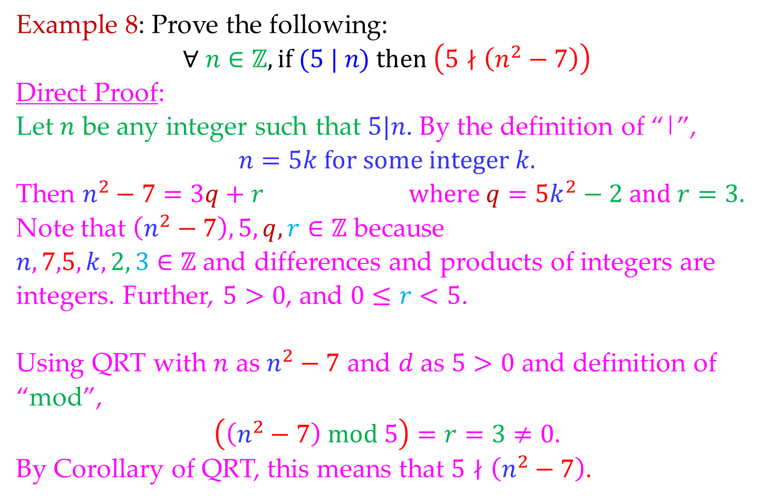
Math 263: Discrete Mathematics
4.5: Quotient Remainder Theorem (QRT)
Example 8: Prove the following:
$$∀ n∈ℤ, if (5 | n) then \left(5∤\left(n^{2}−7\right)\right)$$
Direct Proof:
Let $n$ be any integer such that $5|n$. By the definition of “|”,
$$n=5k for some integer k.$$
Then $n^{2}−7=3q+r where q=5k^{2}−2 and r=3.$
Note that $\left(n^{2}−7\right),5,q, r∈ℤ$ because
$n,7,5,k,2, 3∈ℤ$ and differences and products of integers are integers. Further, $5>0$, and $0≤r<5$.
Using QRT with $n$ as $n^{2}−7$ and $d$ as $5>0$ and definition of “mod”,
$$\left(\left(n^{2}−7\right) mod 5\right)=r=3≠0.$$
By Corollary of QRT, this means that $5∤\left(n^{2}−7\right)$.

Slide 15
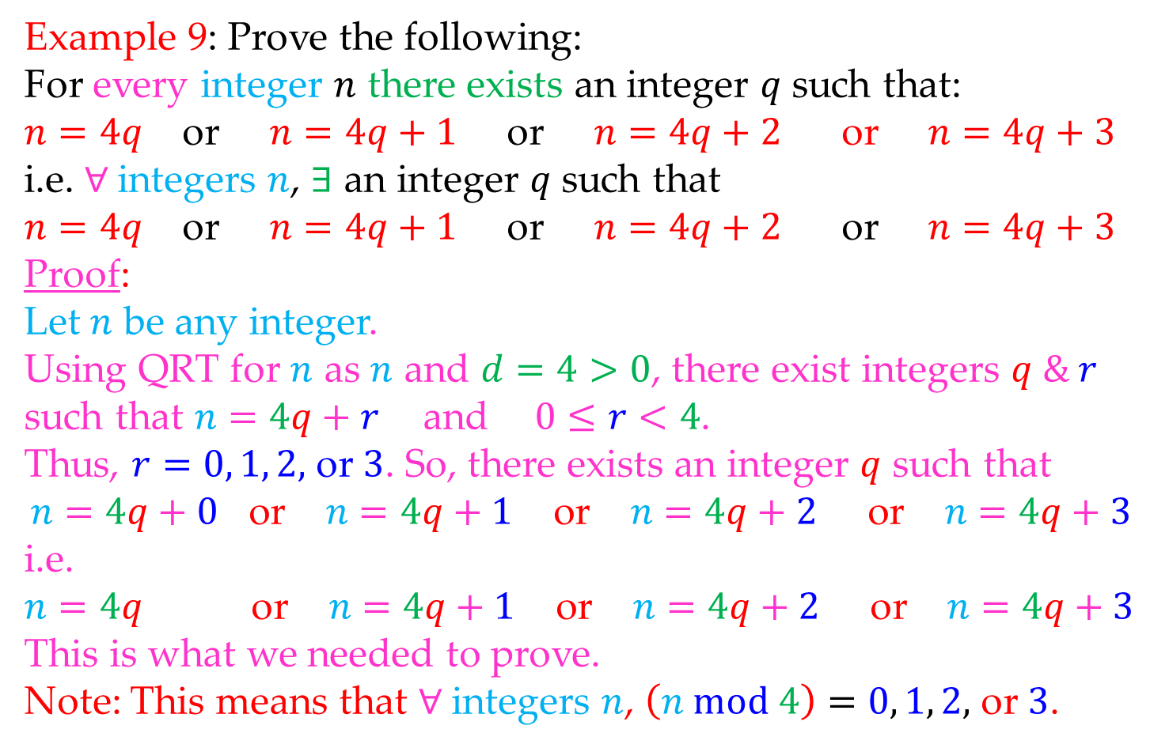
Math 263: Discrete Mathematics
4.5: Quotient Remainder Theorem (QRT)
Example 9: Prove the following:
For every integer $n$ there exists an integer $q$ such that:
$n=4q$ or $n=4q+1$ or $n=4q+2$ or $n=4q+3$
i.e. $∀$integers $n$, $∃$ an integer $q$ such that
$n=4q$ or $n=4q+1$ or $n=4q+2$ or $n=4q+3$
Proof:
Let $n$ be any integer.
Using QRT for $n$ as $n$ and $d=4>0$, there exist integers $q \& r$ such that $n=4q+r$and $0≤r<4$.
Thus, $r=0, 1, 2,$ or $3$. So, there exists an integer $q$ such that
$$n=4q+0 \text{or} n=4q+1 \text{or} n=4q+2 \text{or} n=4q+3$$
i.e.
$$n=4q \text{or} n=4q+1 \text{or} n=4q+2 \text{or} n=4q+3$$
This is what we needed to prove.
Note: This means that $∀$integers $n$, $\left(n mod 4\right)=0, 1, 2,$ or $3$.

Slide 16
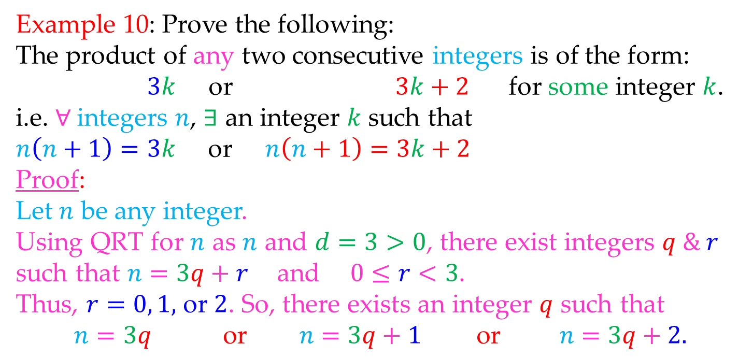
Math 263: Discrete Mathematics
4.5: Quotient Remainder Theorem (QRT)
Example 10: Prove the following:
The product of any two consecutive integers is of the form:
$3k$ or $3k+2$ for some integer $k$.
i.e. $∀$integers $n$, $∃$ an integer $k$ such that
$n\left(n+1\right)=3k$ or $n\left(n+1\right)=3k+2$
Proof:
Let $n$ be any integer.
Using QRT for $n$ as $n$ and $d=3>0$, there exist integers $q \& r$ such that $n=3q+r$and $0≤r<3$.
Thus, $r=0, 1,$ or $2$. So, there exists an integer $q$ such that
$$n=3q \text{or} n=3q+1 \text{or} n=3q+2.$$

Slide 17
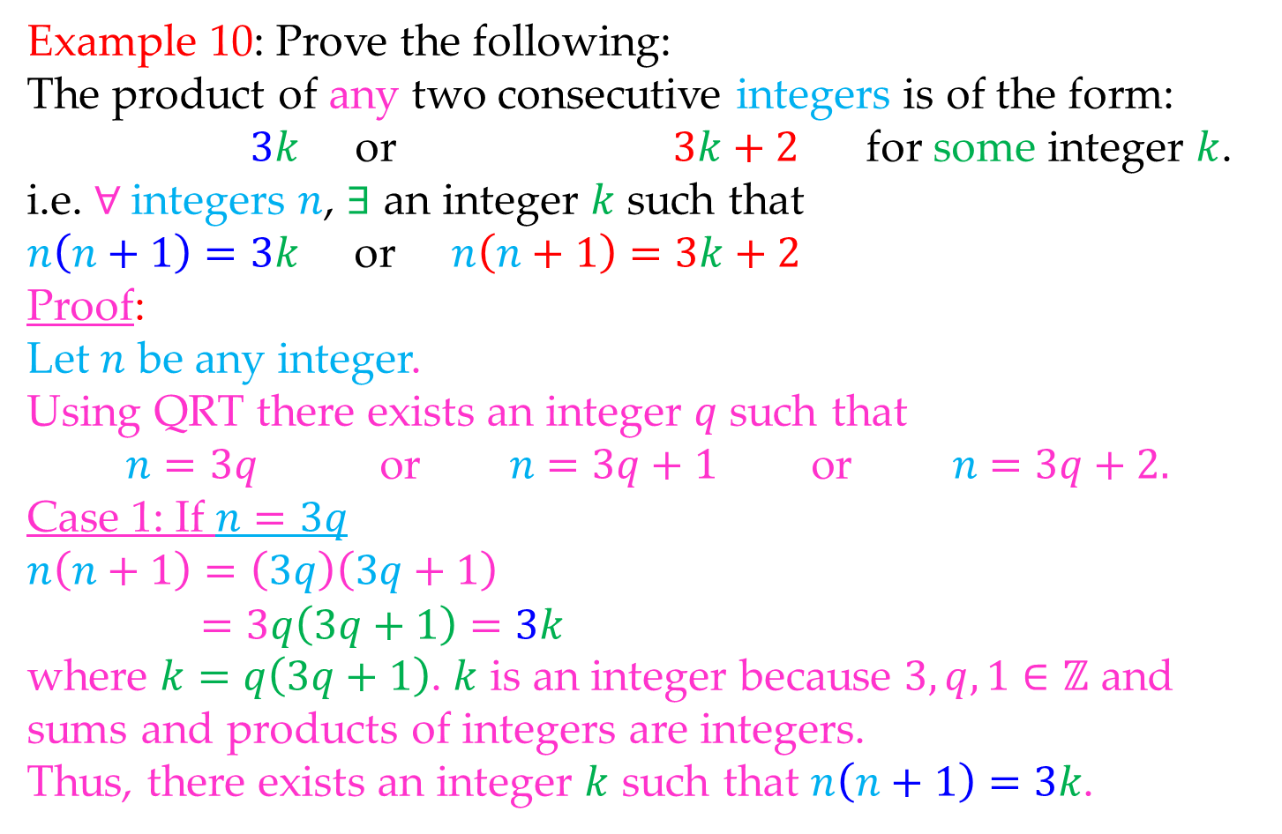
Math 263: Discrete Mathematics
4.5: Quotient Remainder Theorem (QRT)
Example 10: Prove the following:
The product of any two consecutive integers is of the form:
$3k$ or $3k+2$ for some integer $k$.
i.e. $∀$integers $n$, $∃$ an integer $k$ such that
$n\left(n+1\right)=3k$ or $n\left(n+1\right)=3k+2$
Proof:
Let $n$ be any integer.
Using QRT there exists an integer $q$ such that
$$n=3q \text{or} n=3q+1 \text{or} n=3q+2.$$
Case 1: If $n=3q$
$$n\left(n+1\right)=\left(3q\right)\left(3q+1\right)$$
$$=3q\left(3q+1\right)=3k$$
where $k=q\left(3q+1\right)$. $k$ is an integer because $3,q,1∈ℤ$ and
sums and products of integers are integers.
Thus, there exists an integer $k$ such that $n\left(n+1\right)=3k$.

Slide 18
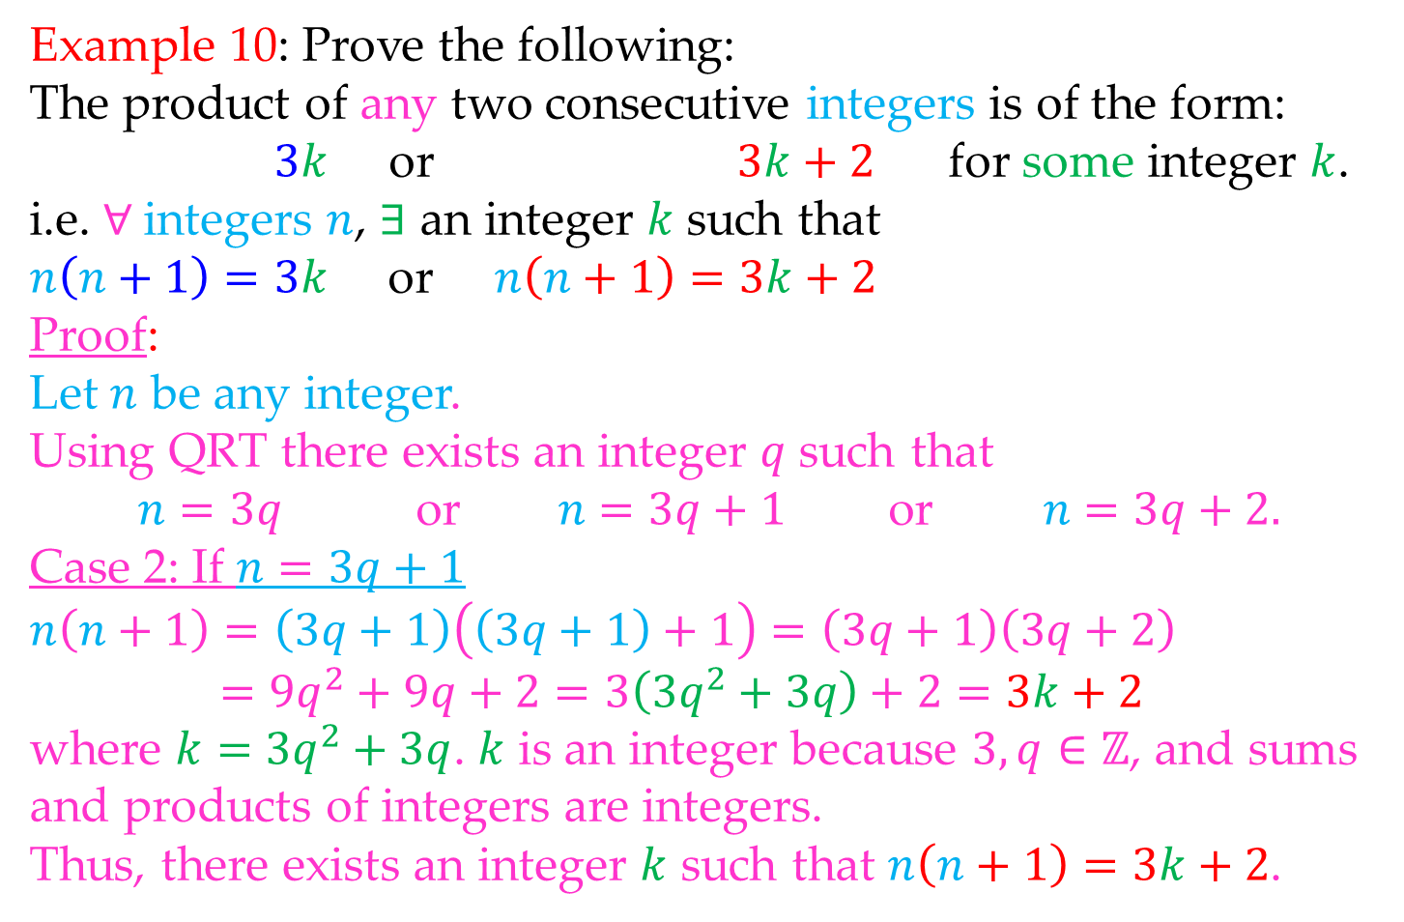
Math 263: Discrete Mathematics
4.5: Quotient Remainder Theorem (QRT)
Example 10: Prove the following:
The product of any two consecutive integers is of the form:
$3k$ or $3k+2$ for some integer $k$.
i.e. $∀$integers $n$, $∃$ an integer $k$ such that
$n\left(n+1\right)=3k$ or $n\left(n+1\right)=3k+2$
Proof:
Let $n$ be any integer.
Using QRT there exists an integer $q$ such that
$$n=3q \text{or} n=3q+1 \text{or} n=3q+2.$$
Case 2: If $n=3q+1$
$$n\left(n+1\right)=\left(3q+1\right)\left(\left(3q+1\right)+1\right)=\left(3q+1\right)\left(3q+2\right)$$
$$=9q^{2}+9q+2=3\left(3q^{2}+3q\right)+2=3k+2$$
where $k=$ $3q^{2}+3q$. $k$ is an integer because $3,q∈ℤ$, and sums
and products of integers are integers.
Thus, there exists an integer $k$ such that $n\left(n+1\right)=3k+2$.

Slide 19
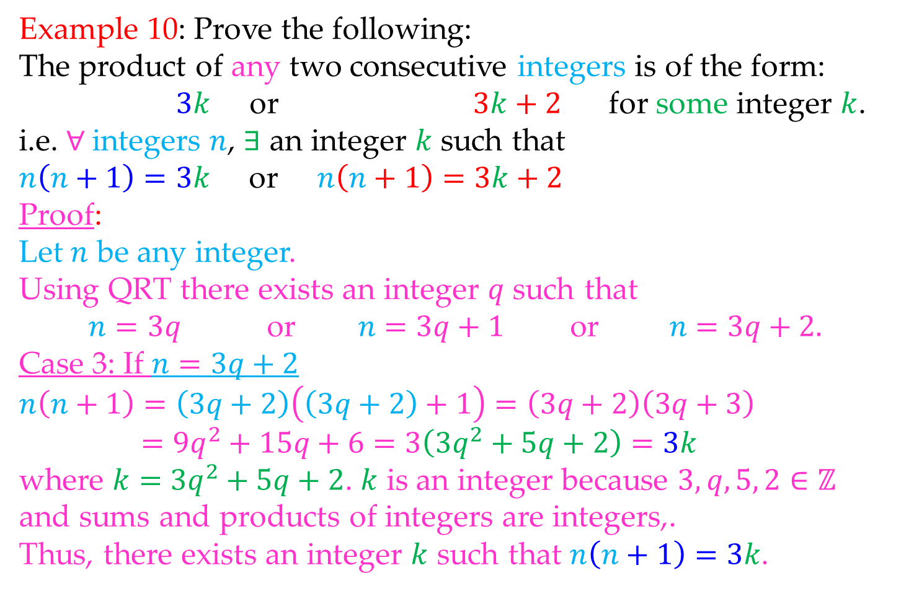
Math 263: Discrete Mathematics
4.5: Quotient Remainder Theorem (QRT)
Example 10: Prove the following:
The product of any two consecutive integers is of the form:
$3k$ or $3k+2$ for some integer $k$.
i.e. $∀$integers $n$, $∃$ an integer $k$ such that
$n\left(n+1\right)=3k$ or $n\left(n+1\right)=3k+2$
Proof:
Let $n$ be any integer.
Using QRT there exists an integer $q$ such that
$$n=3q \text{or} n=3q+1 \text{or} n=3q+2.$$
Case 3: If $n=3q+2$
$$n\left(n+1\right)=\left(3q+2\right)\left(\left(3q+2\right)+1\right)=\left(3q+2\right)\left(3q+3\right)$$
$$=9q^{2}+15q+6=3\left(3q^{2}+5q+2\right)=3k$$
where $k=$ $3q^{2}+5q+2$. $k$ is an integer because $3,q, 5, 2∈ℤ$
and sums and products of integers are integers,.
Thus, there exists an integer $k$ such that $n\left(n+1\right)=3k$.

Slide 20
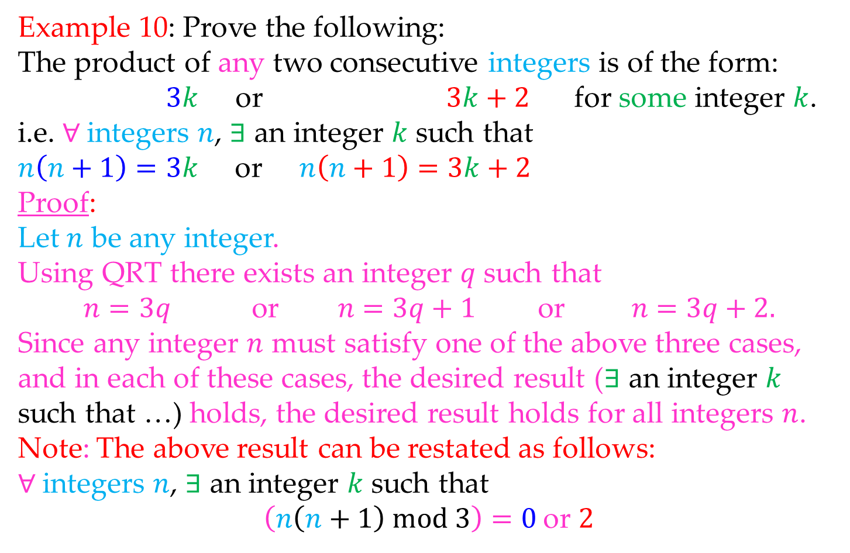
Math 263: Discrete Mathematics
4.5: Quotient Remainder Theorem (QRT)
Example 10: Prove the following:
The product of any two consecutive integers is of the form:
$3k$ or $3k+2$ for some integer $k$.
i.e. $∀$integers $n$, $∃$ an integer $k$ such that
$n\left(n+1\right)=3k$ or $n\left(n+1\right)=3k+2$
Proof:
Let $n$ be any integer.
Using QRT there exists an integer $q$ such that
$$n=3q \text{or} n=3q+1 \text{or} n=3q+2.$$
Since any integer $n$ must satisfy one of the above three cases,
and in each of these cases, the desired result ($∃$ an integer $k$
such that …) holds, the desired result holds for all integers $n$.
Note: The above result can be restated as follows:
$∀$integers $n$, $∃$ an integer $k$ such that
$\left(n\left(n+1\right) mod 3\right)=0$or $2$

Slide 21
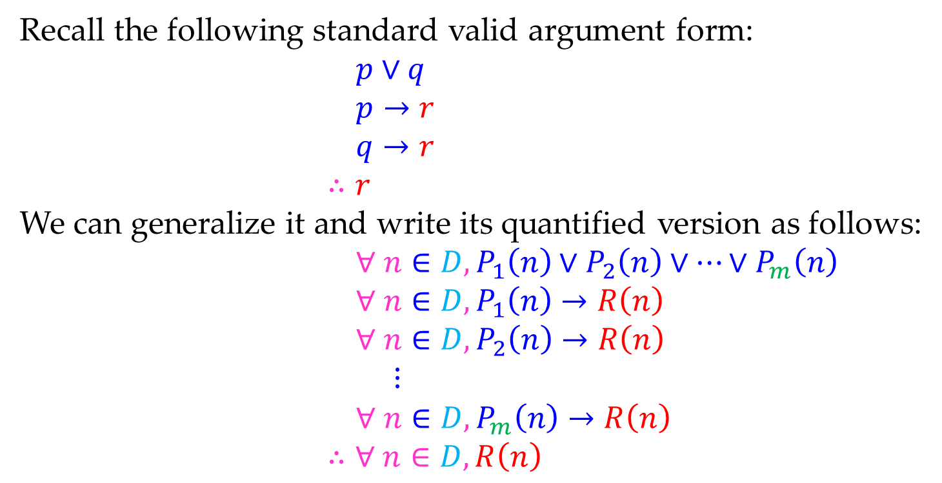
Math 263: Discrete Mathematics
4.5: Proof by Division into Cases
Recall the following standard valid argument form:
$$p∨q$$
$$p→r$$
$$q→r$$
$$∴r$$
We can generalize it and write its quantified version as follows:
$$∀ n∈D, P_{1}\left(n\right)∨P_{2}\left(n\right)∨⋯∨P_{m}\left(n\right)$$
$$∀ n∈D,P_{1}\left(n\right)→R\left(n\right)$$
$$∀ n∈D,P_{2}\left(n\right)→R\left(n\right)$$
$⋮$
$$∀ n∈D,P_{m}\left(n\right)→R\left(n\right)$$
$$∴∀ n∈D,R\left(n\right)$$

Slide 22
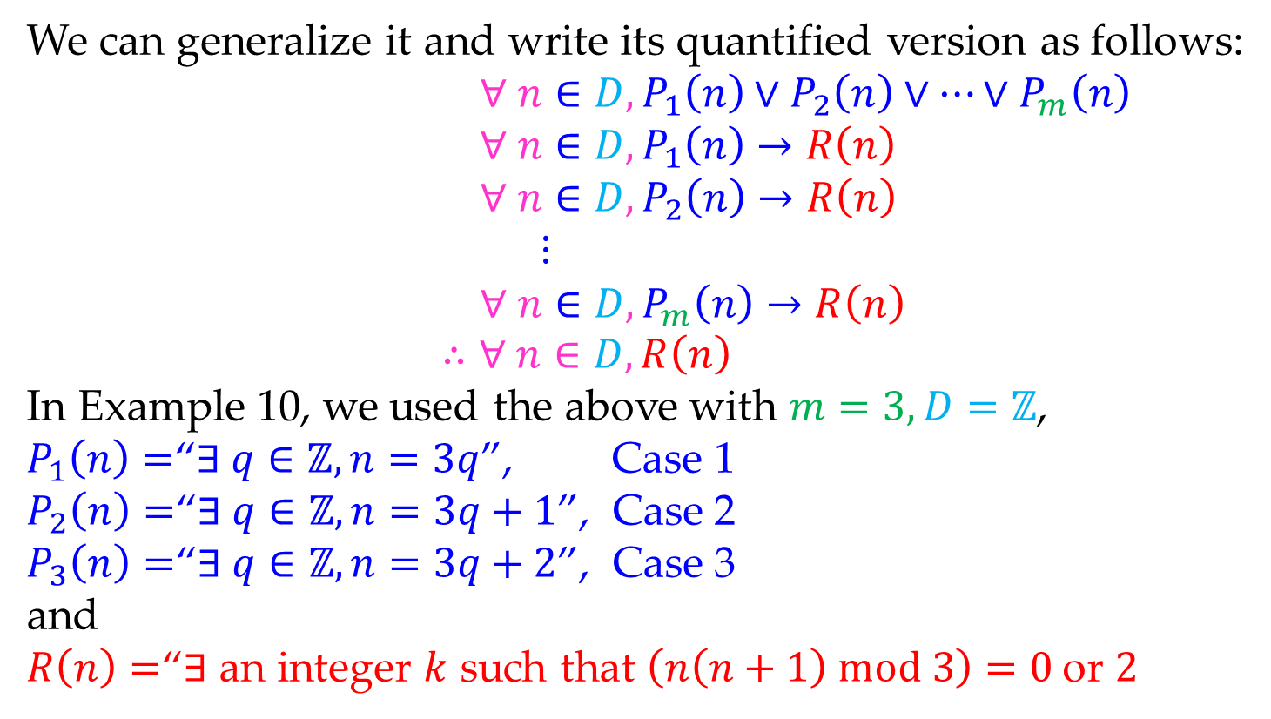
Math 263: Discrete Mathematics
4.5: Proof by Division into Cases
We can generalize it and write its quantified version as follows:
$$∀ n∈D, P_{1}\left(n\right)∨P_{2}\left(n\right)∨⋯∨P_{m}\left(n\right)$$
$$∀ n∈D,P_{1}\left(n\right)→R\left(n\right)$$
$$∀ n∈D,P_{2}\left(n\right)→R\left(n\right)$$
$⋮$
$$∀ n∈D,P_{m}\left(n\right)→R\left(n\right)$$
$$∴∀ n∈D,R\left(n\right)$$
In Example 10, we used the above with $m=3, D=ℤ$,
$P_{1}\left(n\right)=$“$∃ q∈ℤ, n=3q$”, Case 1
$P_{2}\left(n\right)=$“$∃ q∈ℤ,n=3q+1$”, Case 2
$P_{3}\left(n\right)=$“$∃ q∈ℤ, n=3q+2$”, Case 3
and
$R\left(n\right)=$“$∃$ an integer $k$ such that $\left(n\left(n+1\right) mod 3\right)=0$or $2$

Slide 23
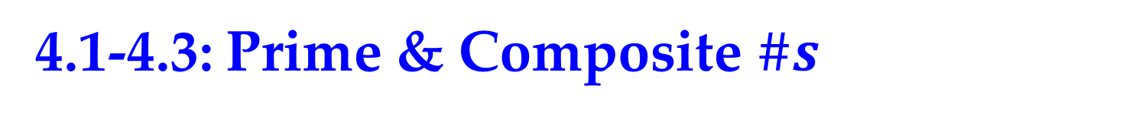
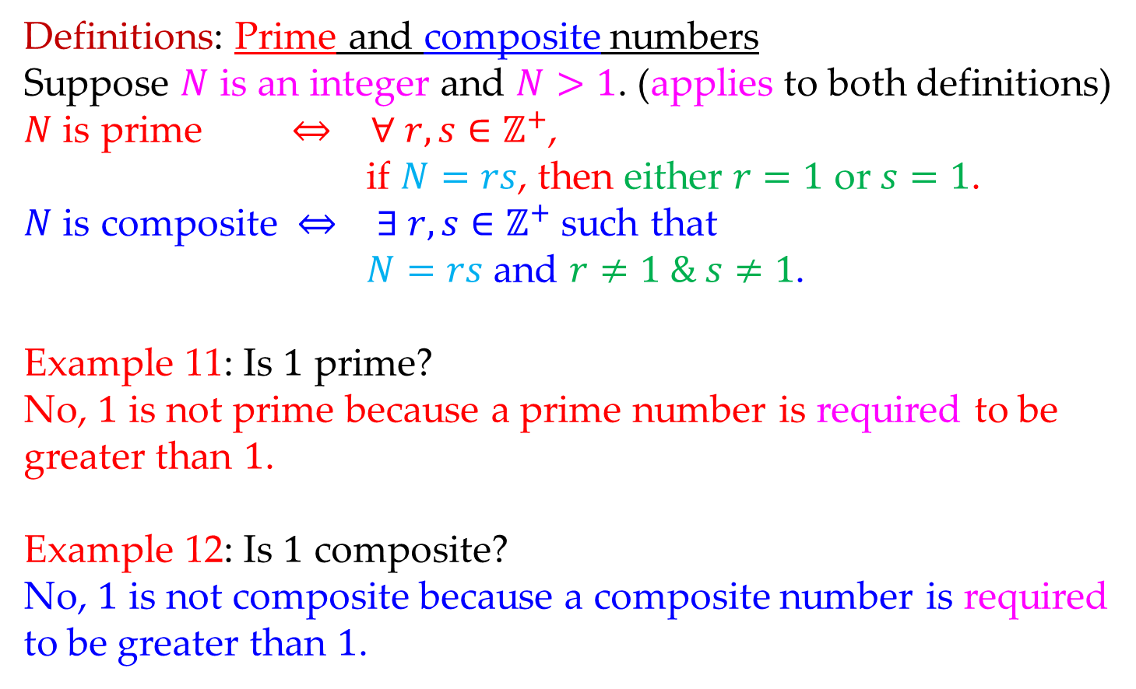
Math 263: Discrete Mathematics
4.1-4.3: Prime & Composite $\#s$
Definitions: Prime and composite numbers
Suppose $N$ is an integer and $N>1$. (applies to both definitions)
$N$ is prime $⇔$ $∀ r,s∈ℤ^{+}$,
if $N=rs$, then either $r=1$ or $s=1$.
$N$ is composite $⇔$ $∃ r,s∈ℤ^{+}$such that
$N=rs$ and $r≠1 \& s≠1$.
Example 11: Is $1$ prime?
No, $1$ is not prime because a prime number is required to be greater than $1$.
Example 12: Is $1$ composite?
No, $1$ is not composite because a composite number is required to be greater than $1$.

Slide 24
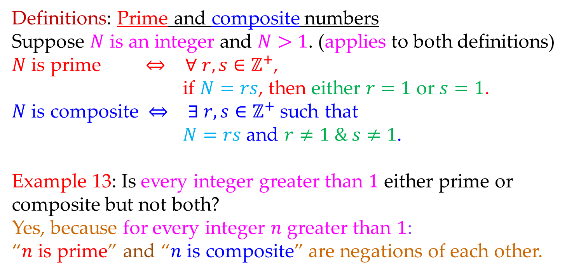
Math 263: Discrete Mathematics
4.1-4.3: Prime & Composite $\#s$
Definitions: Prime and composite numbers
Suppose $N$ is an integer and $N>1$. (applies to both definitions)
$N$ is prime $⇔$ $∀ r,s∈ℤ^{+}$,
if $N=rs$, then either $r=1$ or $s=1$.
$N$ is composite $⇔$ $∃ r,s∈ℤ^{+}$such that
$N=rs$ and $r≠1 \& s≠1$.
Example 13: Is every integer greater than $1$ either prime or composite but not both?
Yes, because for every integer $n$ greater than $1$:
“$n$ is prime” and “$n$ is composite” are negations of each other.

Slide 25





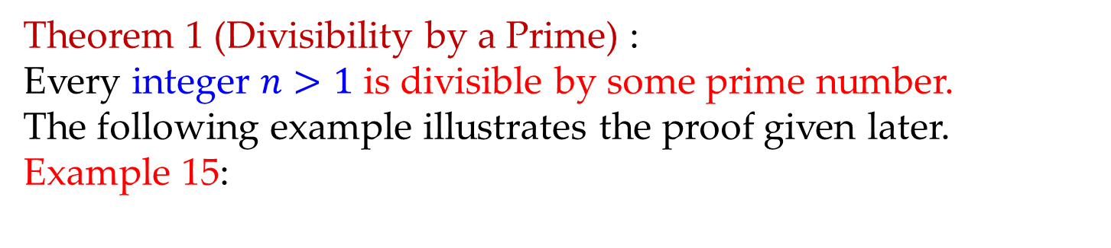



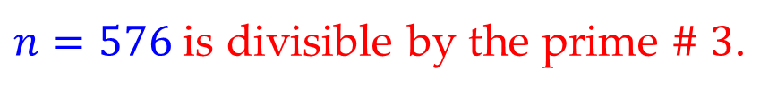


Math 263: Discrete Mathematics
4.4: Number Theory
Theorem 1 (Divisibility by a Prime) :
Every integer $n>1$ is divisible by some prime number.
The following example illustrates the proof given later.
Example 15:
$$n=576$$
Not prime
$$r_{0}=72$$
$$s_{0}=8$$
$$n=72⋅8$$
$$r_{1}=18$$
$$s_{1}=4$$
$$n=18⋅4⋅8$$
$$r_{2}=3$$
$$s_{2}=6$$
$$n=3⋅6⋅4⋅8$$
$n=576$ is divisible by the prime $\#$ $3$.
Prime

Slide 26
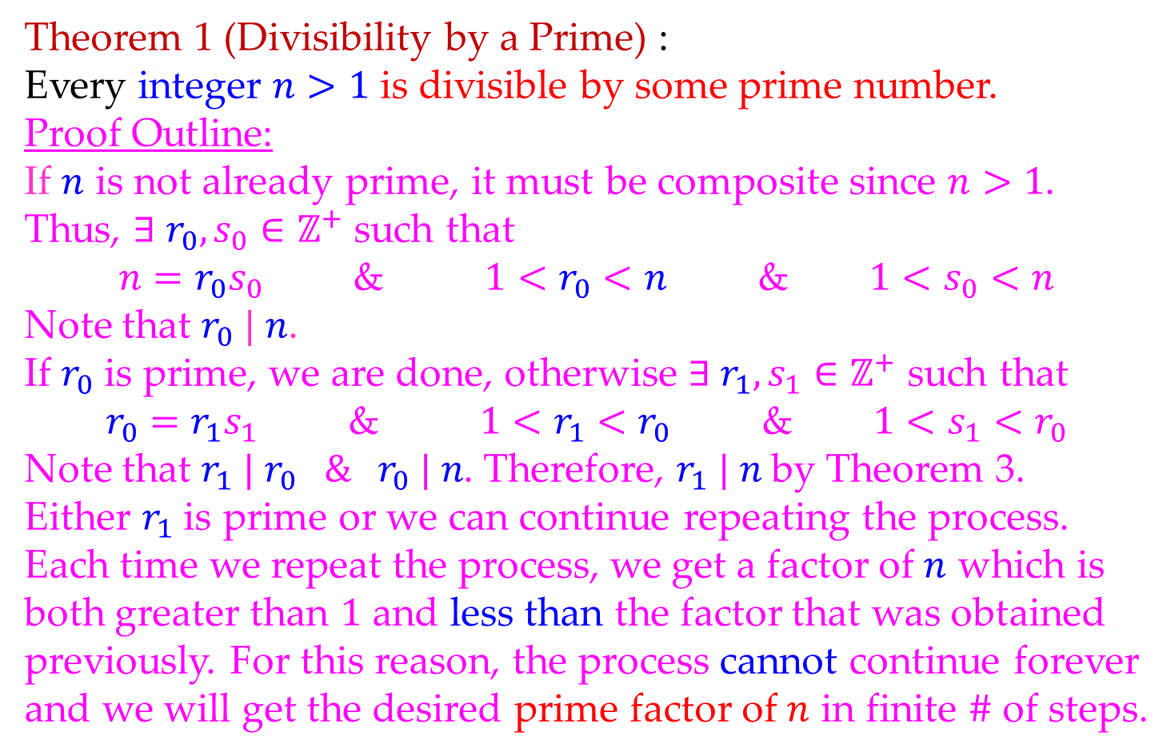
Math 263: Discrete Mathematics
4.4: Number Theory
Theorem 1 (Divisibility by a Prime) :
Every integer $n>1$ is divisible by some prime number.
Proof Outline:
If $n$ is not already prime, it must be composite since $n>1$.
Thus, $∃ r_{0},s_{0}∈ℤ^{+}$ such that
$n=r_{0}s_{0}$ & $1<r_{0}<n$ & $1<s_{0}<n$
Note that $r_{0} | n$.
If $r_{0}$ is prime, we are done, otherwise $∃ r_{1},s_{1}∈ℤ^{+}$ such that
$r_{0}=r_{1}s_{1}$ & $1<r_{1}<r_{0}$ & $1<s_{1}<r_{0}$
Note that $r_{1} | r_{0} \& r_{0} | n$. Therefore, $r_{1} | n$ by Theorem 3.
Either $r_{1}$ is prime or we can continue repeating the process.
Each time we repeat the process, we get a factor of $n$ which is
both greater than $1$ and less than the factor that was obtained
previously. For this reason, the process cannot continue forever
and we will get the desired prime factor of $n$ in finite $\#$ of steps.

Slide 27
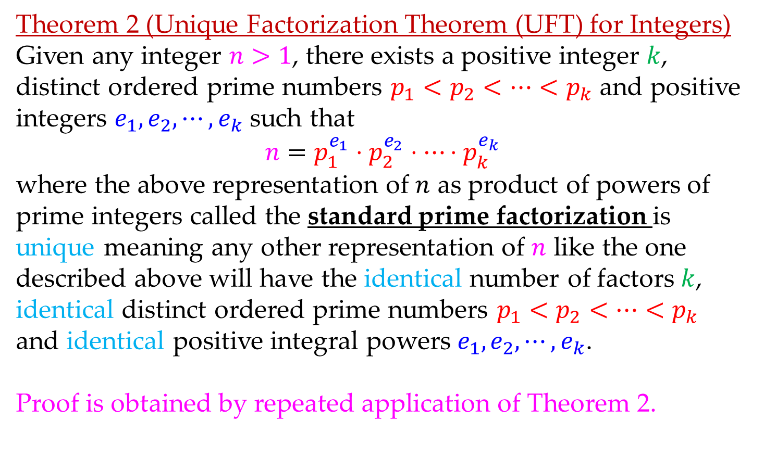
Math 263: Discrete Mathematics
4.4: Unique Factorization Theorem
Theorem 2 (Unique Factorization Theorem (UFT) for Integers)
Given any integer $n>1$, there exists a positive integer $k$, distinct ordered prime numbers $p_{1}<p_{2}<⋯<p_{k}$ and positive integers $e_{1}, e_{2}, ⋯, e_{k}$ such that
$$n=p_{1}^{e_{1}}⋅p_{2}^{e_{2}}⋅⋯⋅p_{k}^{e_{k}}$$
where the above representation of $n$ as product of powers of prime integers called the standard prime factorization is unique meaning any other representation of $n$ like the one described above will have the identical number of factors $k$, identical distinct ordered prime numbers $p_{1}<p_{2}<⋯<p_{k}$ and identical positive integral powers $e_{1}, e_{2}, ⋯, e_{k}$.
Proof is obtained by repeated application of Theorem 2.

Slide 28







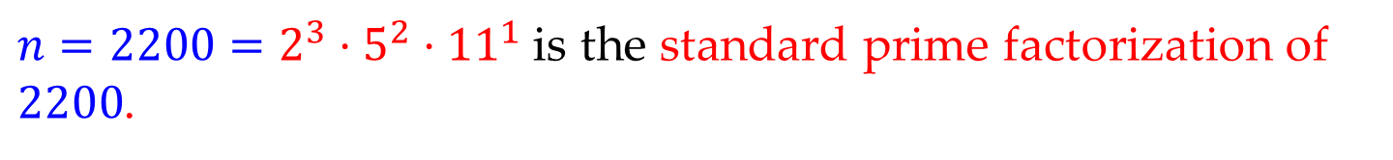




Math 263: Discrete Mathematics
4.4: Unique Factorization Theorem
Example 16: Write standard prime factorization of $n=2200$.
$$n=2200$$
Not prime
$$22$$
$$100$$
$$2$$
$$11$$
$$25$$
$$4$$
$$5$$
$$5$$
$$2$$
$$2$$
$n=2200=2^{3}⋅5^{2}⋅{11}^{1}$ is the standard prime factorization of $2200$.

Slide 29
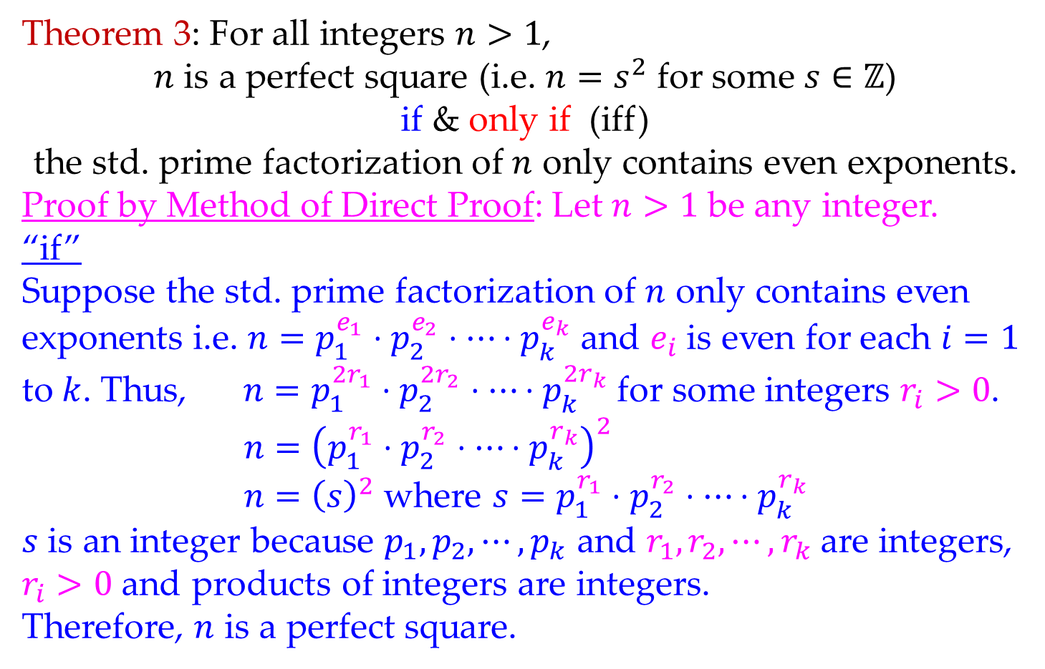
Math 263: Discrete Mathematics
4.4: Unique Factorization Theorem
Theorem 3: For all integers $n>1$,
$n$ is a perfect square (i.e. $n=s^{2}$ for some $s∈ℤ$)
if & only if (iff)
the std. prime factorization of $n$ only contains even exponents.
Proof by Method of Direct Proof: Let $n>1$ be any integer.
“if”
Suppose the std. prime factorization of $n$ only contains even
exponents i.e. $n=p_{1}^{e_{1}}⋅p_{2}^{e_{2}}⋅⋯⋅p_{k}^{e_{k}}$ and $e_{i}$ is even for each $i=1$
to $k$. Thus, $n=p_{1}^{{2r}_{1}}⋅p_{2}^{{2r}_{2}}⋅⋯⋅p_{k}^{{2r}_{k}}$ for some integers $r_{i}>0$.
$$n={\left(p_{1}^{r_{1}}⋅p_{2}^{r_{2}}⋅⋯⋅p_{k}^{r_{k}}\right)}^{2}$$
$n={\left(s\right)}^{2}$ where $s=p_{1}^{r_{1}}⋅p_{2}^{r_{2}}⋅⋯⋅p_{k}^{r_{k}}$
$s$ is an integer because $p_{1}, p_{2},⋯,p_{k}$ and $r_{1}, r_{2},⋯,r_{k}$are integers,
$r_{i}>0$ and products of integers are integers.
Therefore, $n$ is a perfect square.
Proof of “only if” is HW

Slide 30
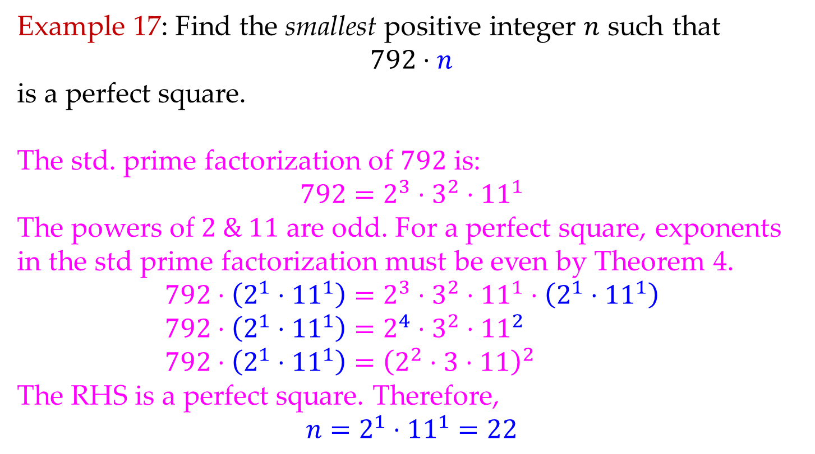
Math 263: Discrete Mathematics
4.4: Unique Factorization Theorem
Example 17: Find the smallest positive integer $n$ such that
$792⋅n$
is a perfect square.
The std. prime factorization of $792$ is:
$$792=2^{3}⋅3^{2}⋅{11}^{1}$$
The powers of $2 \& 11$ are odd. For a perfect square, exponents
in the std prime factorization must be even by Theorem 4.
$$792⋅\left(2^{1}⋅{11}^{1}\right)=2^{3}⋅3^{2}⋅{11}^{1}⋅\left(2^{1}⋅{11}^{1}\right)$$
$$792⋅\left(2^{1}⋅{11}^{1}\right)=2^{4}⋅3^{2}⋅{11}^{2}$$
$$792⋅\left(2^{1}⋅{11}^{1}\right)={\left(2^{2}⋅3⋅11\right)}^{2}$$
The RHS is a perfect square. Therefore,
$$n=2^{1}⋅{11}^{1}=22$$

Slide 31
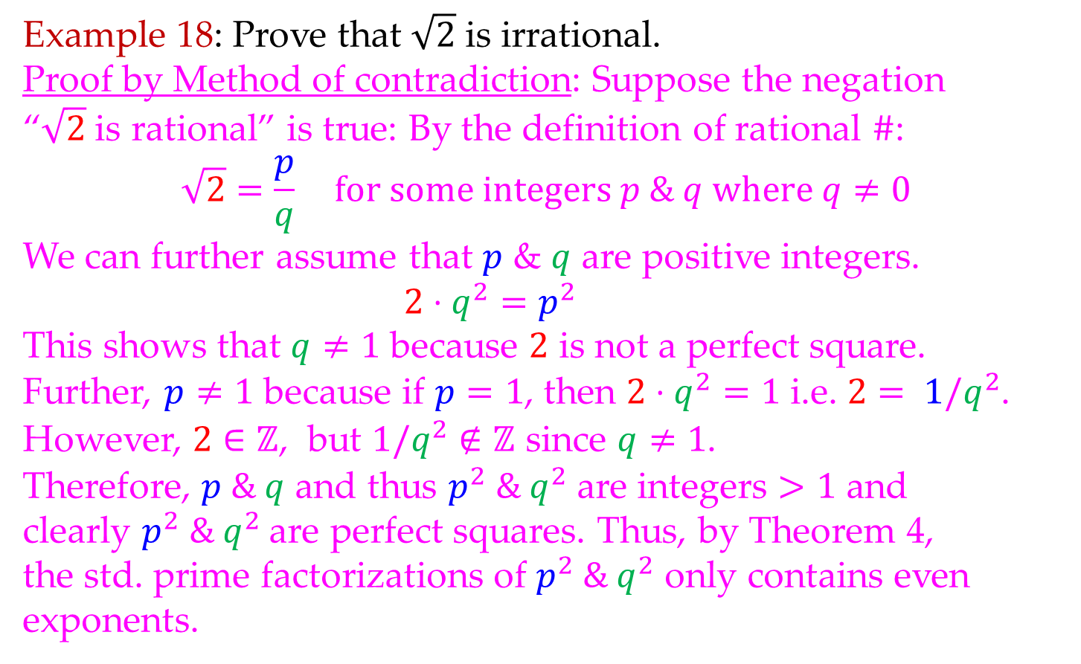
Math 263: Discrete Mathematics
4.4: Classical Theorem
Example 18: Prove that $\sqrt{2}$ is irrational.
Proof by Method of contradiction: Suppose the negation
“$\sqrt{2}$ is rational” is true: By the definition of rational $\#$:
$$\sqrt{2}=\frac{p}{q} for some integers p \& q where q≠0$$
We can further assume that $p$ & $q$ are positive integers.
$$2⋅q^{2}=p^{2}$$
This shows that $q≠1$ because $2$ is not a perfect square.
Further, $p≠1$ because if $p=1$, then $2⋅q^{2}=1$ i.e. $2= 1/q^{2}$.
However, $2∈ℤ$, but $1/q^{2}∉ℤ$ since $q≠1$.
Therefore, $p \& q$ and thus $p^{2} \& q^{2}$ are integers $>1$ and
clearly $p^{2} \& q^{2}$are perfect squares. Thus, by Theorem 4,
the std. prime factorizations of $p^{2} \& q^{2}$ only contains even exponents.

Slide 32
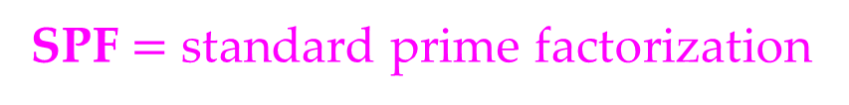
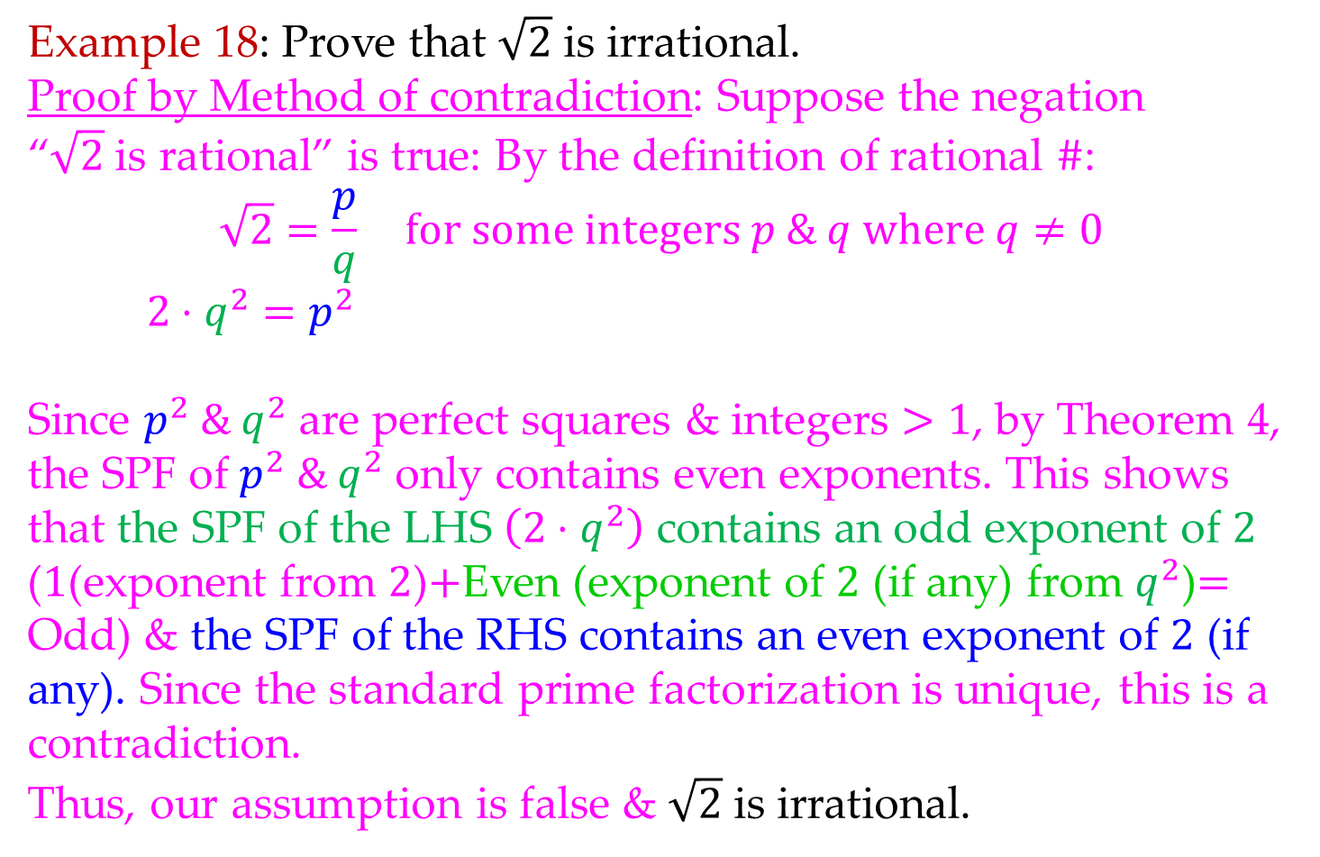
Math 263: Discrete Mathematics
4.4: Classical Theorem
Example 18: Prove that $\sqrt{2}$ is irrational.
Proof by Method of contradiction: Suppose the negation
“$\sqrt{2}$ is rational” is true: By the definition of rational $\#$:
$$\sqrt{2}=\frac{p}{q} for some integers p \& q where q≠0$$
$$2⋅q^{2}=p^{2}$$
Since $p^{2} \& q^{2}$ are perfect squares & integers $>1$, by Theorem 4,
the SPF of $p^{2} \& q^{2}$ only contains even exponents. This shows
that the SPF of the LHS $\left(2⋅q^{2}\right)$ contains an odd exponent of $2$
($1$(exponent from $2$)$+$Even (exponent of $2$ (if any) from $q^{2}$)$=$
Odd) & the SPF of the RHS contains an even exponent of $2$ (if
any). Since the standard prime factorization is unique, this is a
contradiction.
Thus, our assumption is false & $\sqrt{2}$ is irrational.
SPF $=$ standard prime factorization

Slide 33
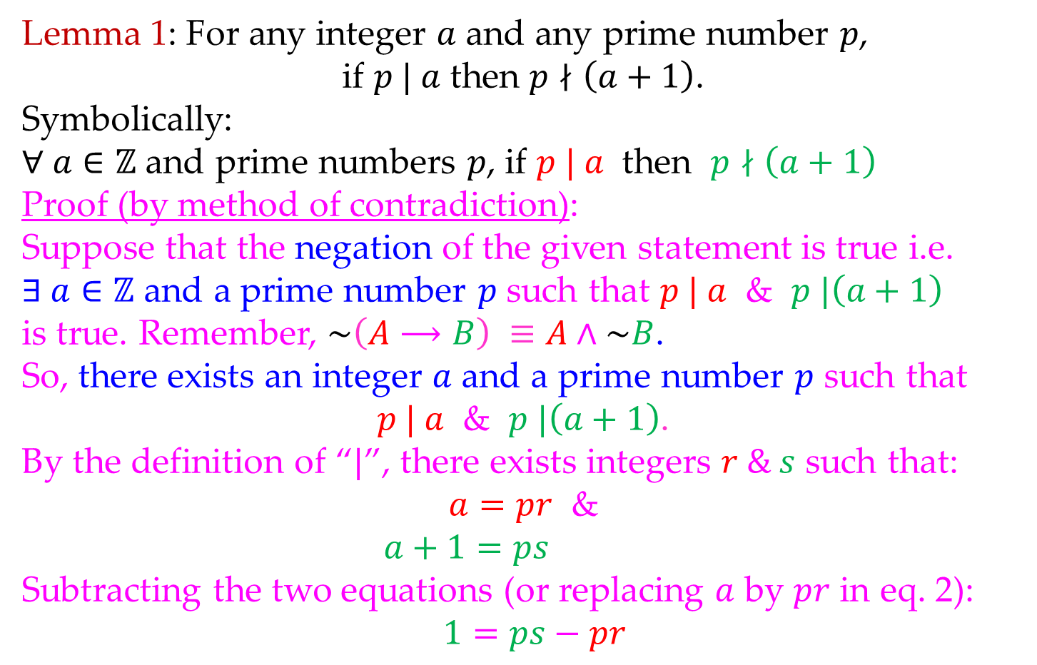
Math 263: Discrete Mathematics
4.4: Classical Theorem
Lemma 1: For any integer $a$ and any prime number $p$,
if $p | a$ then $p∤\left(a+1\right)$.
Symbolically:
$∀ a∈ℤ$ and prime numbers $p$, if $p | a$ then $p∤\left(a+1\right)$
Proof (by method of contradiction):
Suppose that the negation of the given statement is true i.e.
$∃ a∈ℤ$ and a prime number $p$ such that $p | a$ & $p |\left(a+1\right)$
is true. Remember, $\sim \left(A⟶B\right) ≡A∧\sim B$.
So, there exists an integer $a$ and a prime number $p$ such that
$p | a$ & $p |\left(a+1\right)$.
By the definition of “$|$”, there exists integers $r \& s$ such that:
$a=pr$ &
$$a+1=ps$$
Subtracting the two equations (or replacing $a$ by $pr$ in eq. 2):
$$1=ps−pr$$

Slide 34
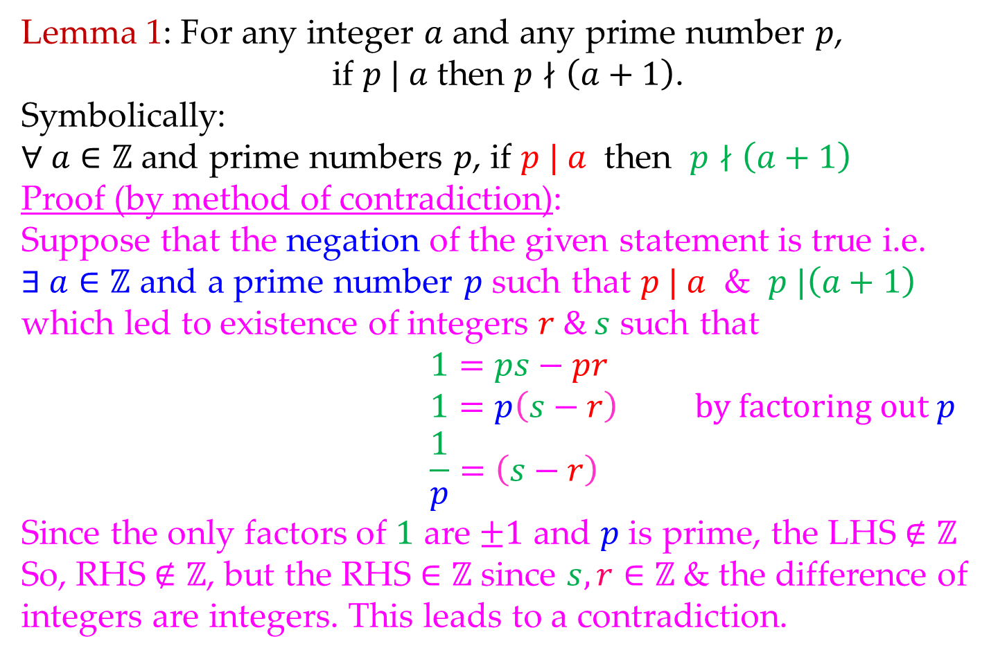
Math 263: Discrete Mathematics
4.4: Classical Theorem
Lemma 1: For any integer $a$ and any prime number $p$,
if $p | a$ then $p∤\left(a+1\right)$.
Symbolically:
$∀ a∈ℤ$ and prime numbers $p$, if $p | a$ then $p∤\left(a+1\right)$
Proof (by method of contradiction):
Suppose that the negation of the given statement is true i.e.
$∃ a∈ℤ$ and a prime number $p$ such that $p | a$ & $p |\left(a+1\right)$
which led to existence of integers $r \& s$ such that
$$1=ps−pr$$
$$1=p\left(s−r\right) by factoring out p$$
$$\frac{1}{p}=\left(s−r\right)$$
Since the only factors of $1$ are $±1$ and $p$ is prime, the LHS $∉ℤ$
So, RHS $∉ℤ$, but the RHS $∈ℤ$ since $s, r∈ℤ$& the difference of
integers are integers. This leads to a contradiction.

Slide 35
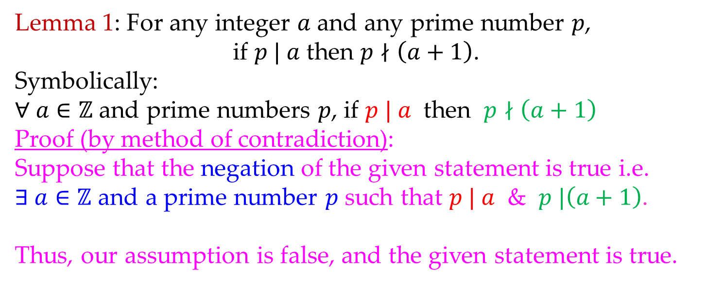
Math 263: Discrete Mathematics
4.4: Classical Theorem
Lemma 1: For any integer $a$ and any prime number $p$,
if $p | a$ then $p∤\left(a+1\right)$.
Symbolically:
$∀ a∈ℤ$ and prime numbers $p$, if $p | a$ then $p∤\left(a+1\right)$
Proof (by method of contradiction):
Suppose that the negation of the given statement is true i.e.
$∃ a∈ℤ$ and a prime number $p$ such that $p | a$ & $p |\left(a+1\right)$.
Thus, our assumption is false, and the given statement is true.

Slide 36
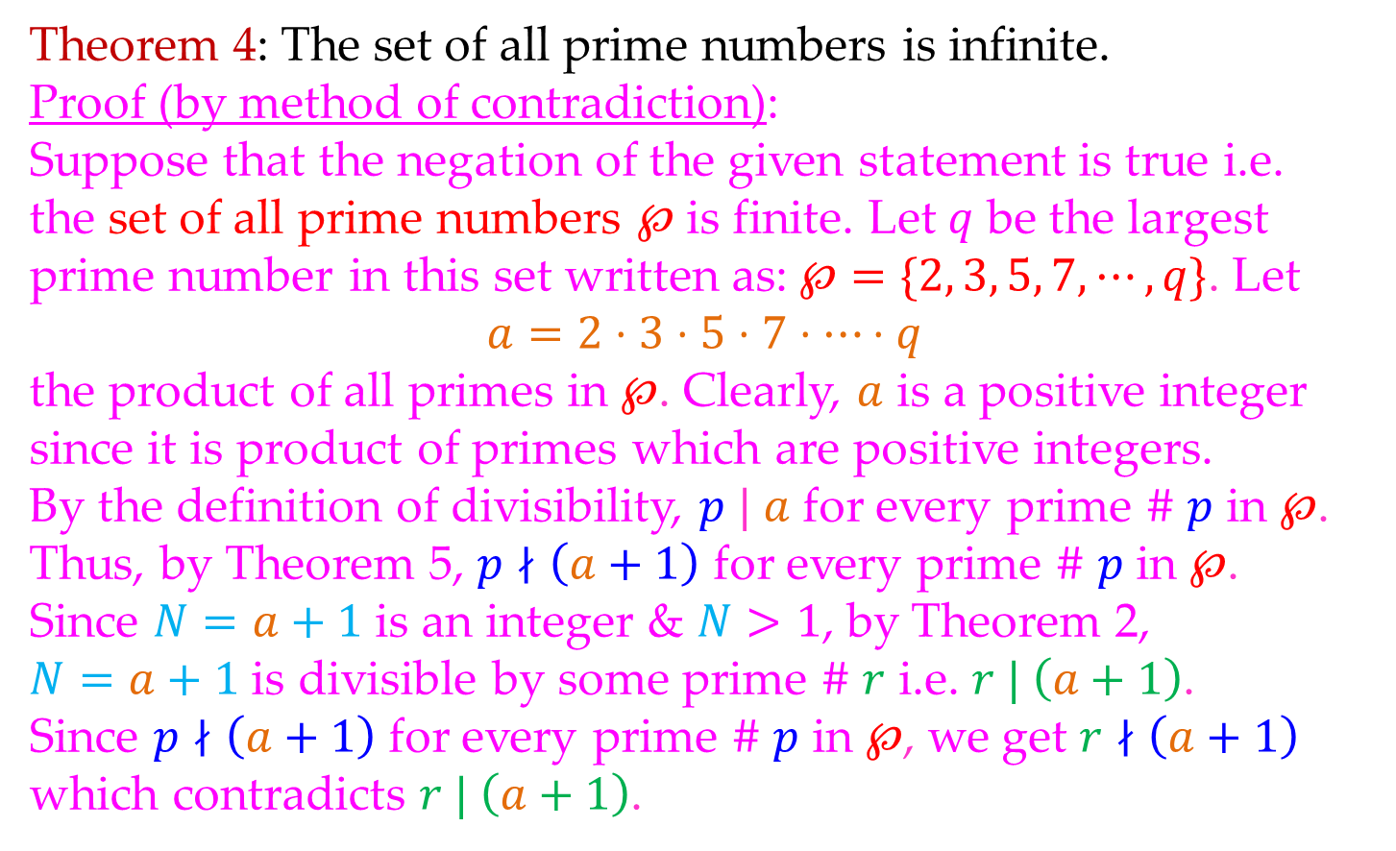
Math 263: Discrete Mathematics
4.4: Classical Theorem
Theorem 4: The set of all prime numbers is infinite.
Proof (by method of contradiction):
Suppose that the negation of the given statement is true i.e.
the set of all prime numbers $℘$ is finite. Let $q$ be the largest
prime number in this set written as: $℘=\{2, 3, 5, 7, ⋯,q\}$. Let
$a=2⋅3⋅5⋅7⋅⋯⋅q$
the product of all primes in $℘$. Clearly, $a$ is a positive integer since it is product of primes which are positive integers.
By the definition of divisibility, $p | a$ for every prime $\#$ $p$ in $℘$.
Thus, by Theorem 5, $p∤\left(a+1\right)$ for every prime $\#$ $p$ in $℘$.
Since $N=a+1$ is an integer & $N>1$, by Theorem 2,
$N=a+1$ is divisible by some prime $\#$ $r$ i.e. $r | \left(a+1\right)$.
Since $p∤\left(a+1\right)$ for every prime $\#$ $p$ in $℘$, we get $r∤\left(a+1\right)$
which contradicts $r | \left(a+1\right)$.

Slide 37
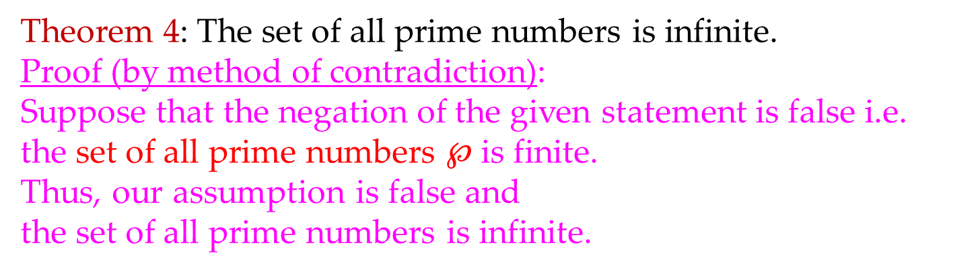
Math 263: Discrete Mathematics
4.4: Classical Theorem
Theorem 4: The set of all prime numbers is infinite.
Proof (by method of contradiction):
Suppose that the negation of the given statement is false i.e.
the set of all prime numbers $℘$ is finite.
Thus, our assumption is false and
the set of all prime numbers is infinite.

